Slide 1
Algorithm Analysis

Slide 2
Objectives
Understand the meaning of an algorithm.
Describe various applications of algorithms.
Distinguish between empirical and analytical methods for analyzing algorithms.
Understand the use of Big-Oh notation for expressing the performance of an algorithm in terms of time and space utilization.
Learn rules for specifying the behavior of algorithm for large data inputs.

Slide 3
Introduction to algorithms
The design and analysis of algorithm is one of the essential key topics in computer science.
we often encounter several algorithms for the same problem, and we must decide which is best.
This leads us to the interesting and all-important field of analysis of algorithms whose overall goal is an understanding of the complexity of algorithms.
The general idea is to take a particular algorithm and determine its quantitative behavior.

Slide 4
Introduction to algorithms
An algorithm can be defined as follows:
  An algorithm is a set of rules for carrying out calculation either by hand or on a machine.
  An algorithm is a finite step-by-step procedure to achieve a required results.
  An algorithm is a sequence of computational steps that transform the input into the output.
  An algorithm is a sequence of operations performed on data that have to be organized in data structures.
  An algorithm is an abstraction of a program to be executed on physical machine (model of computation).

Slide 5
Introduction to algorithms
Algorithmic is a branch of computer science that consists of designing and analyzing computer algorithms. The design pertains to the description of algorithm at an abstract level by means of a pseudo language, and proof of correctness that, the algorithm solves the given problem in all cases.. The analysis deals with performance evaluation (complexity analysis).
An algorithm is a finite sequence of instructions, each of which has a clear meaning and can be performed with a finite amount of effort in a finite length of time.

Slide 6
Characteristics of an Algorithm
Not all procedures can be called an algorithm. An algorithm should have the following characteristics −
  Unambiguous − Algorithm should be clear and unambiguous. Each of its steps (or phases), and their inputs/outputs should be clear and must lead to only one meaning.
  Input − An algorithm should have 0 or more well-defined inputs.
  Output − An algorithm should have 1 or more well-defined outputs, and should match the desired output.
  Finiteness − Algorithms must terminate after a finite number of steps.
  Feasibility − Should be feasible with the available resources.
  Independent − An algorithm should have step-by-step directions, which should be independent of any programming code.

Slide 7
Specification of Algorithms
Algorithms are generally expressed in human readable form.
Two approaches are: natural language and pseudo code.
Use of Natural Language
  English words and phrases can be used to express statements and processing steps.
    For example, words like read, write, compute and set can be used for IO operations computation and assigning values to variables comparison operations are expressed as equal to, less than, greater than
    Arithmetic operations are expressed using words like add, subtract, divide and multiply
    Control structures are coded using phrases like repeat for, while, if, halt, exit

Slide 8
Specification of Algorithms
Use of Pseudo code
Algorithms in natural language tend to be wordy and verbose
Pseudo code provides an alternative way for expressing algorithms.
It is a mixture of natural language and programming notation.
In practice several convention are used to write pseudo code
The following notation is commonly used:
  Algorithm is identified by a name
  Comments are enclosed in square brackets
  Variable names are written in capital letters
  Assignment statement is coded using arrow

Slide 9
Specification of Algorithms
Use of Pseudo code
Operators are identified by algebraic symbols (+,-,*,/,<,>,=,!=)
Input and output statements are expressed using words read and write
Control structures are described using phrases if-then, if-then-else.
Repetitive operations are described by phrases Repeat, for while, until.

Slide 10
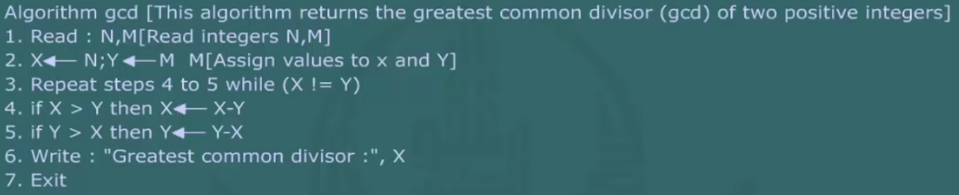
Specification of Algorithms
The Euclid’s algorithm can be expressed in pseudo code as under:

Slide 11
Algorithm analysis
Performance is measured in terms of running time and storage requirements.
Algorithm that takes enormously long time is not useful for real time applications.
Algorithms that require large storage cannot be implemented on small computers.
Time and space analysis are of crucial importance for the efficiency of a software module.
Time analysis uses two approaches to estimate the running time.
The analysis methods are classified as empirical/experimental and analytical method

Slide 12
Algorithm analysis: Empirical/Experimental Analysis
One way to study the efficiency of an algorithm is to implement it and experiment by running the program on various test inputs while recording the time spent during each execution
The key is that if we record the time immediately before executing the algorithm and then immediately after, we can measure the elapsed time of an algorithm’s execution by computing the difference of those times.
Because we are interested in the general dependence of running time on the size and structure of the input, we should perform independent experiments on many different test inputs of various sizes.

Slide 13
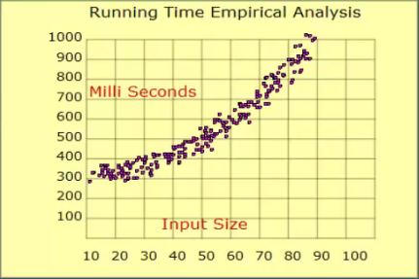
Algorithm analysis: Empirical/Experimental Analysis
Running time is measured for different sets of input values.
Actual time is plotted against the input size to analyze growth rate.

Slide 14
Algorithm analysis: Empirical/Experimental Analysis
However, the measured times reported by any two methods will vary greatly from machine to machine, and may likely vary from trial to trial, even on the same machine. (CPU – Memory).
Experiments are quite useful when comparing the efficiency of two or more algorithms, so long as they gathered under similar circumstances.

Slide 15
Challenges of Experimental Analysis
Experimental running times of two algorithms are difficult to directly compare unless the experiments are performed in the same hardware and software environments.
Experiments can be done only on a limited set of test inputs; hence, they leave out the running times of inputs not included in the experiment (and these inputs may be important).
An algorithm must be fully implemented in order to execute it to study its running time experimentally.

Slide 16
Moving Beyond Experimental Analysis
Our goal is to develop an approach to analysing the efficiency of algorithms that:
  Allows us to evaluate the relative efficiency of any two algorithms in a way that is independent of the hardware and software environment.
  Is performed by studying a high-level description of the algorithm without need for implementation.
  Takes into account all possible inputs.

Slide 17
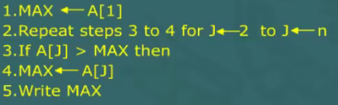
Algorithm analysis: Analytical Method
This analysis uses mathematical techniques to estimate the running time.
It identifies time consuming crucial operations in an algorithm.
The number of key operations can be determined by analyzing the pseudo code.
For example, consider the pseudo code find the largest value in an array A of size N

Slide 18
Time complexity
Total running time is
It is not concerned with determining the running time of a particular value of input.
It covers the entire range of values.

Slide 19
Performance Analysis
In Software Engineering, performance analysis is the investigation of a program’s behavior using information gathered as the program runs.
The goal of performance analysis is to determine which parts of a program to optimize for speed and memory usage
Every algorithm must use some of a computer’s resources to complete its task. The resources most relevant to efficiency are central processor time(CPU time) and internal memory (RAM).
This is done by computing the complexity of algorithm; which is a function describing the efficiency of the algorithm in terms of the amount of data the algorithm must process.
In other words, the two important ways to characterize the effectives of an algorithm are its space complexity and time complexity.
The computing time and storage requirements of an algorithm have a more direct relationship to performance.

Slide 20
Space Complexity
The space complexity of an algorithm (for a given input) is the number of elementary objects that this algorithms needs to store during its execution. This number is computed with respect to the size of input data.
Or Space complexity is a function describing the amount of memory (space) an algorithm takes in terms of the amount of input to the algorithm.
The space occupied by an algorithm is determined by the number and sizes of the variables and data structures used by the algorithms.
The space complexity of a problem is related concept that measures the amount of space or memory required by the algorithm

Slide 21
Time complexity
The number of machine instructions which a program executes during its running time is called its time complexity. This number depends primarily on the size of the program’s input.
Or Time complexity is a function describing the amount of time an algorithm takes in terms of the amount of input to the algorithm.
The time required by an algorithm is determined by the number of elementary operations.
We may be able to reduce space requirements by increasing the running time or conversely reduce time requirements by increasing memory space. This situation is referred to as the space complexity trade off.

Slide 22
Counting Primitive Operations
To analyze the running time of an algorithm without performing experiments, we perform an analysis directly on a high-level description of the algorithm (either in the form of an actual code fragment, or language-independent pseudocode).
Primitive operation is a low-level instruction with constant time.
Counting the primitive operations can be used as measure for algorithm performance.
We define a set of primitive operations such as the following:
  Assigning a value to a variable
  Following an object reference
  Performing an arithmetic operation (for example, adding two numbers)
  Comparing two numbers
  Accessing a single element of an array by index
  Calling a method
  Returning from a method

Slide 23
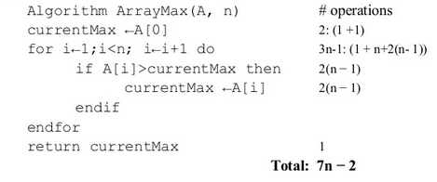
Counting Primitive Operations
Total number of primitive operations
  Is the running time of an algorithms
  Is a function of the input size
Example

Slide 24
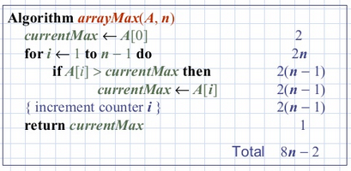
Counting Primitive Operations
By inspecting the pseudo code, we can determine the maximum number of primitive operations executed by an algorithm, as a function of the input size.

Slide 25
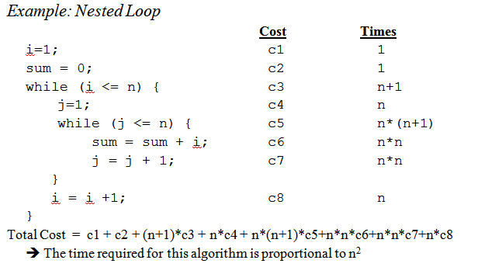
Counting Primitive Operations

Slide 26
Algorithm growth Rates
To capture the order of growth of an algorithm’s running time, we will associate, with each algorithm, a function f (n) that characterizes the number of primitive operations that are performed as a function of the input size n.
Often we need to know how running time varies with the variation of input size.
Behavior of an algorithm for large input is called asymptotic growth.

Slide 27
Algorithm growth Rates
In previous example on slide 21, the running time for MAX algorithm varies as kN+c
We can say that running time of MAX algorithm asymptotically varies as N
Figure below shows the comparative behavior of two algorithms.
Observe that for input size less than 5 second algorithm has better performance.
On the other hand the second algorithm shows much better performance for large values of inputs

Slide 28
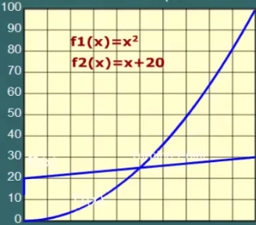
Algorithm Growth Rates

Slide 29
Seven Functions used in Analysis
It is generally written as
Polynomial time algorithms,
  O(1) --- Constant time --- the time does not change in response to the size of the problem.
  O(n) --- Linear time --- the time grows linearly with the size (n) of the problem.
  O(n²) --- Quadratic time --- the time grows quadratically with the size (n) of the problem. In big O notation, all polynomials with the same degree are equivalent, so O(3n² + 3n + 7) = O(n²)
Sub-linear time algorithms
  O(logn) -- Logarithmic time
Super-polynomial time algorithms
  O(n!)
  O(2^{n})

Slide 30
Algorithm Growth Function
Logarithmic Algorithm
  Running time varies as log N, where N is size of problem.
  It grows slowly, and has the best performance.
  If the problem size increases by factor of 1000, running time increases by 10
  Example Binary search algorithm

Slide 31
Algorithm Growth Function
Linear Algorithm
Execution time grows in direct proportion to the size of a problem.
Performance is rated as good
Algorithm, which are based on a single loop, shows linear growth rate.
Examples are: searching, deleting and inserting operations in an array

Slide 32
Algorithm Growth Function
N Log N Algorithm
N log N has high growth rate
Divide – and – Conquer algorithms show this behavior
Quadratic Algorithm
Quadratic algorithm grows as square of input size
Problems with two nested loops show quadratic behavior.
For example multiplication of two NxN matrices has O(N²) running time.
Quadratic algorithms have fast growth rates.

Slide 33
Algorithm Growth Function
Cubic Algorithm
  Running time of a cubic algorithm varies as the cube of the problem size.
  Cubic algorithms grow very rapidly.
  Problems with three nested loops show cubic behavior
  Traversal of a three dimension array has running time O(N³)
Exponential Algorithm
  Exponential algorithm has running time of the order of 2^{N}
  Growths at high rate, it is not very useful.
  Here is a comparison of growth rates of commonly used algorithm functions
O(log N) < O(N) < O(N log N) < O(N²) < O(N³) < (2^{N})

Slide 34

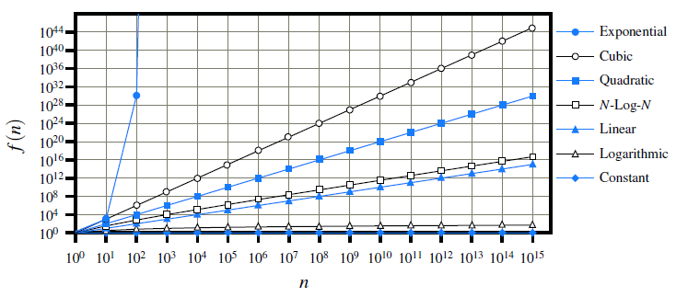
Comparing Growth Rates

Slide 35
Asymptotic Analysis
Knowing the complexity of algorithms allows you to answer questions such as
  How long will a program run on an input?
  How much space will it take?
  Is the problem solvable?
An understanding of algorithmic complexity provides programmers with insight into the efficiency of their code. Complexity is also important to several theoretical areas in computer science, including algorithms, data structures, and complexity theory.

Slide 36
Asymptotic Analysis
Asymptotic analysis refers to computing the running time of any operation in mathematical units of computation. For example, running time of one operation is computed as f(n) and may be for another operation it is computed as g(n²).
Which means first operation running time will increase linearly with the increase in n and running time of second operation will increase exponentially when n increases. Similarly the running time of both operations will be nearly same if n is significantly small.

Slide 37
Asymptotic Analysis
Usually, time required by an algorithm falls under three types −
  Best Case − Minimum time required for program execution.
  Average Case − Average time required for program execution.
  Worst Case − Maximum time required for program execution.
Asymptotic Notations
  Following are commonly used asymptotic notations used in calculating running time complexity of an algorithm.
  Ο Notation
  Ω Notation
  θ Notation

Slide 38
In Depth Running Time Analysis
Generally we perform analysis to find maximum, average and minimum running times
Best case Analysis
  Best case analysis is used to determine the minimum running time of an algorithm.
  Execution time depends on the nature of input data.
  In Searching problems, for example, the most favorable input is the one which matches with the very first item in a data collection.
  Likewise, in sorting problems, the best scenario would be when items are already in sorted order.
  The best case analysis has little practical value.

Slide 39
In Depth Running Time Analysis
Worst Case Analysis
  Worst case analysis determines the running time for most unfavorable input.
  It provides maximum running time for a given input.
  In searching, for example, when an item matching with the search key happens to occur at the end of a data collection.
  Thus worst case analysis yields the most pessimistic time estimate.
  It, however, guarantees that in all circumstances, running time would never exceed the estimated time.
  In almost all applications, algorithm analysis is done on a worst-case basis.

Slide 40
In Depth Running Time Analysis
Average Case Analysis
Average case analysis is done to find out the average running time for an algorithm.
It lies somewhere between the optimistic and pessimistic times.
In searching problem, for example the average running time would be when a data item matching with the search key lies in the middle of a data collection.
The average case analysis often relies on probability theory. In most cases it is difficult to determine average running time of an algorithm.

Slide 41
The “Big-Oh” Notation
The Ο(n) is the formal way to express the upper bound of an algorithm's running time. It measures the worst case time complexity or longest amount of time an algorithm can possibly take to complete.
Definition :Let f (n) and g(n) be functions, where n is a positive integer. We say that f (n) is O(g(n)) if there is a real constant c > 0 and an integer constant n0 ≥ 1 such that
f (n) ≤ c ·g(n), for n ≥ n0.
This definition is often referred to as the “big-Oh” notation, for it is sometimes pronounced as “ f (n) is big-Oh of g(n).”

Slide 42
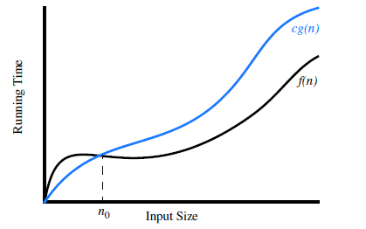
The “Big-Oh” Notation
Illustrating the “big-Oh” notation. The function f (n) is O(g(n)), since f (n) ≤ c ·g(n) when n ≥ n0.

Slide 43
The “Big-Oh” Notation
Examples 1: Show 3n² + 4n - 2 = O(n²).
We need to find c and n₀ such that:
3n² + 4n - 2 <= cn² for all n >= n₀ .
Divide both sides by n², getting:
3 + 4/n - 2/n² <= c for all n >= n₀ .
If we choose n₀ equal to 1, then we need a value of c such that:
3 + 4 - 2 <= c
We can set c equal to 6. Now we have:
3n² + 4n - 2 <= 6n² for all n >= 1 .

Slide 44
The “Big-Oh” Notation
Examples 2: Show n³ != O(n^{2).}
Let's assume to the contrary that
n³ != O(n²).
Then there must exist constants c and n₀ such that
n³ != cn². for all n >= n₀.
Dividing by n², we get:
n <= c for all n >= n₀.
But this is not possible; we can never choose a constant c large enough that n will never exceed it, since n can grow without bound.
Thus, the original assumption, that n³ = O(n²), must be wrong so n³ != O(n²).

Slide 45
Some Properties of the Big-Oh Notation
It provides a convenient method for expressing asymptotic behavior of an algorithm
When input size becomes large, we simplify Big-Oh representation.
  Any constants in an expression may be ignored.
    O(N² + 100) = O(N²)
  Lower order terms may be dropped in favor of the highest order term in an expression
    O(N³ + 2N² + N) = O(N³)
  The multiplication constants may be ignored.
    O(20N³) = O(N³)

Slide 46
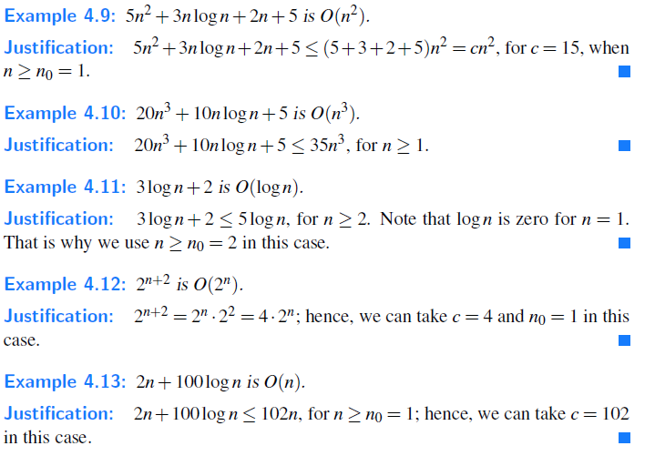
Let us consider some further examples here, focusing on combinations of the seven fundamental functions used in algorithm design. We rely on the mathematical fact that logn ≤ n for n ≥ 1.

Slide 47
Big-Omega Notation, Ω
The Ωn is the formal way to express the lower bound of an algorithm's running time. It measures the best case time complexity or best amount of time an algorithm can possibly take to complete.
Definition: Let f (n) and g(n) be functions mapping positive integers to positive real numbers. We say that f (n) is W(g(n)), pronounced “ f (n) is big-Omega of g(n),” if g(n) is O( f (n)), that is, there is a real constant c> 0 and an integer constant n₀ ≥ 1 such that
f (n) ≥ cg(n), for n ≥ n0.
This definition allows us to say asymptotically that one function is greater than or equal to another, up to a constant factor.

Slide 48
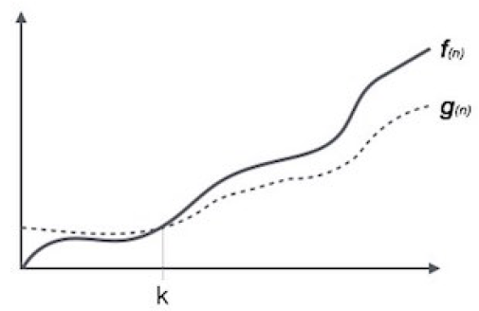
Big-Omega Notation, Ω

Slide 49
Big-Omega Notation, Ω
Example : 3nlogn − 2n is Ω(nlog n).
Justification: 3nlogn −2n = nlogn +2n(logn−1) ≥ nlog n for n ≥ 2; hence,
we can take c = 1 and n₀ = 2 in this case.

Slide 50
Big-Theta Notation, θ
In addition, there is a notation that allows us to say that two functions grow at the same rate, up to constant factors.
Definition: We say that f (n) is Q(g(n)), pronounced “ f (n) is big-Theta of g(n),” if f (n) is O(g(n)) and f (n) is Ω(g(n)), that is, there are real constants c′ > 0 and c′′ > 0, and an integer constant n0 ≥ 1 such that
c′g(n) ≤ f (n) ≤ c′′g(n), for n ≥ n₀.
Example : 3nlog n+4n+5logn is θ(nlog n).
Justification: 3nlog n ≤ 3nlog n+4n+5logn ≤ (3+4+5)nlogn for n ≥ 2.

Slide 51
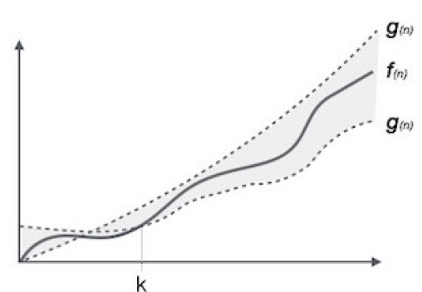
Big-Theta Notation, θ
The θn is the formal way to express both the lower bound and upper bound of an algorithm's running time. It is represented as following -

Slide 52
Space Analysis
Space analysis is concerned with determining the maximum storage requirement needed to implement a particular algorithm.
It provides an estimate of number of bytes as function of input size
Variables and constants occupy fixed storage, which does not depend on input size.
  Therefore, the space utilization for constants and variables is O(1).

Slide 53
Space Analysis
For complex data structures, space utilization is estimated by counting the number of bytes.
For example, an array of integers of size N, would require 4N bytes.
  The space complexity would be O(N)
In some applications, there is trade-off between running time and storage requirement.
a large data file can be sored more efficiency in shorter time by using large memory space.
  For example, data of two arrays can be merged more efficiently by using a third array

